Slide 1

Session 4 Data Science Process and Data Wrangling

Slide 2
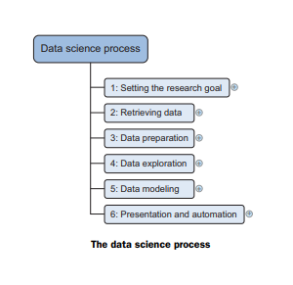
Data science process
A structured approach to data science helps to maximize chances of success in a data science project at the lowest cost.
It also makes it possible to take up a project as a team, with each team member focusing on what they do best.
However: this approach may not be suitable for every type of project or be the only way to do good data science.
The typical data science process consists of six steps through which will iterate, as shown in figure.

Slide 3
Data science process
1. Setting the research goal
Data science is mostly applied in the context of an organization.
When the business asks to perform a data science project, first prepare a project charter.
This charter contains information such as what is the work going to research, how the company benefits from that, what data and resources you need, a timetable, and deliverables.
2. Retrieving data
The second step is to collect data.
Stated in the project charter which data is need and where can find it.
In this step ensure to use the data in program, which means checking the existence of, quality, and access to the data.
Data can also be delivered by third-party companies and takes many forms ranging from Excel spreadsheets to different types of databases.

Slide 4
Continue…
3. Data Preparation
Data collection is an error-prone process;
In this phase enhance the quality of the data and prepare it for use in subsequent steps.
This phase consists of three sub phases:
data cleansing removes false values from a data source and inconsistencies across data sources,
data integration enriches data sources by combining information from multiple data sources, and
data transformation ensures that the data is in a suitable format for use in models.
4. Data exploration
Data exploration is concerned with building a deeper understanding of data.
Try to understand how variables interact with each other, the distribution of the data, and whether there are outliers.
To achieve this mainly use descriptive statistics, visual techniques, and simple modeling.
This step often goes by the abbreviation EDA, for Exploratory Data Analysis

Slide 5
Continue…
5. Data modeling or model building
In this phase use models, domain knowledge, and insights about the data found in the previous steps to answer the research question.
Select a technique from the fields of statistics, machine learning, operations research, and so on.
Building a model is an iterative process that involves selecting the variables for the model, executing the model, and model diagnostics.
6. Presentation and automation
Finally, present the results to business.
These results can take many forms, ranging from presentations to research reports.
Sometimes need to automate the execution of the process because the business will want to use the insights gained in another project or enable an operational process to use the outcome from model.

Slide 6
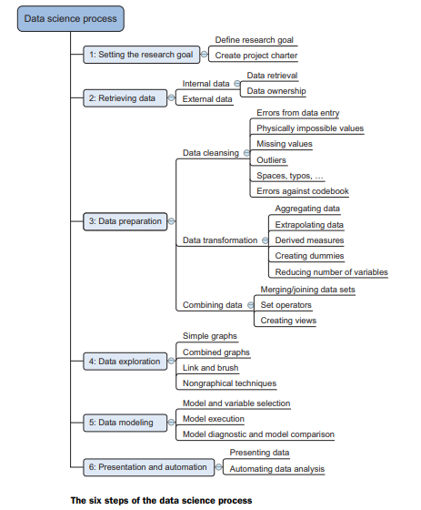
Overview of Data science process

Slide 7
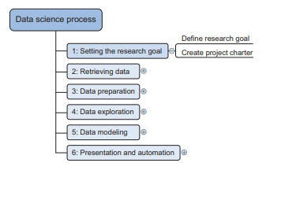
Step 1: Defining research goals and creating a project charter
A project starts by understanding the what, the why, and the how the project.
What does the company expect you to do? And why does management place such a value on your research?
Is it part of a bigger strategic picture or a “lone wolf” project originating from an opportunity someone detected?
Project Charter Creation
A project charter requires teamwork, and your input covers at least the following:
■ A clear research goal
■ The project mission and context
■ How you’re going to perform your analysis
■ What resources you expect to use
■ Proof that it’s an achievable project, or proof of concepts
■ Deliverables and a measure of success
■ A timeline

Slide 8
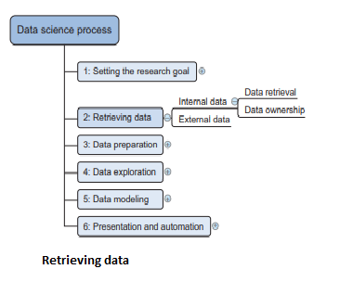
Step 2: Retrieving data
Data can be stored in many forms, ranging from simple text files to tables in a database.
The objective is acquiring all the needed data.
This may be difficult, and even if succeed, data is often like a diamond in the rough: it needs polishing to be of any use.
This data can be stored in official data repositories such as databases, data marts, data warehouses, and data lakes maintained by a team of IT professionals.
The primary goal of a database is data storage, while a data warehouse is designed for reading and analyzing that data.

Slide 9
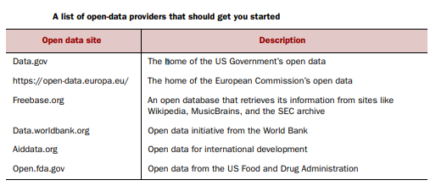
Continue…
A data mart is a subset of the data warehouse and geared toward serving a specific business unit.
While data warehouses and data marts are home to preprocessed data, data lakes contains data in its natural or raw format.
But the possibility exists that data still resides in Excel files on the desktop of a domain expert.

Slide 10
Step 3: Cleansing, integrating, and transforming data
The data received from the data retrieval phase is likely to be “a diamond in the rough.”
Next to sanitize and prepare it for use in the modeling and reporting phase.
Doing so is tremendously important because models will perform better and will lose less time trying to fix strange output.
It can’t be mentioned nearly enough times: garbage in equals garbage out.
Figure shows the most common actions to take during the data cleansing, integration, and transformation phase.
Data cleansing
Data cleansing is a sub process of the data science process that focuses on removing errors in the data.
So the data becomes a true and consistent representation of the processes it originates from.

Slide 11
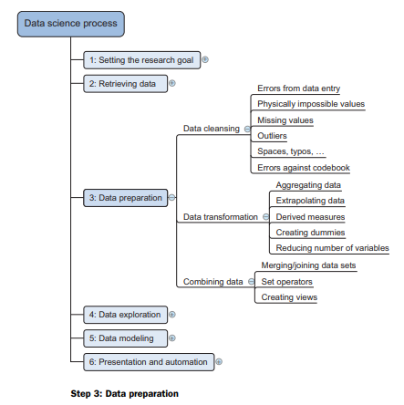
Continue…

Slide 12
Continue…
By “true and consistent representation”
two types of errors exist
first type is the interpretation error, such as when take the value in the data for granted, like saying that a person’s age is greater than 300 years.
second type of error points to inconsistencies between data sources or against company’s standardized values.
Example: of this class of errors is putting “Female” in one table and “F” in another when they represent the same thing: that the person is female.
table shows an overview of the types of errors that can be detected with easy checks—the “low hanging fruit,” as it were.

Slide 13
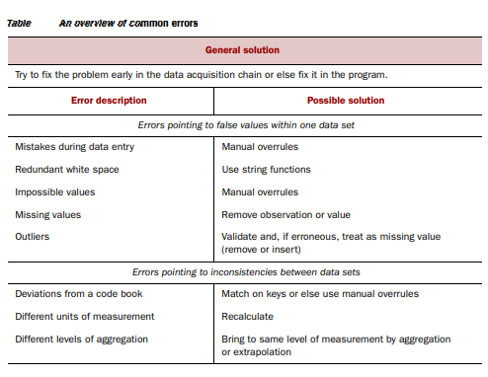
Continue…

Slide 14
Combining data from different data sources
Data comes from several different places, and in this sub step focus on integrating these different sources.
Data varies in size, type, and structure, ranging from databases and Excel files to text documents.
two operations to combine information from different data sets.
First operation is joining:
enriching an observation from one table with information from another table.
Second operation is appending or stacking:
adding the observations of one table to those of another table.

Slide 15
Transforming data
Certain models require their data to be in a certain shape.
Now cleansed and integrated the data, this is the next task to perform:
transforming your data so it takes a suitable form for data modeling.
Relationships between an input variable and an output variable aren’t always linear.
Take, for instance, a relationship of the form y = ae bx.
Taking the log of the independent variables simplifies the estimation problem dramatically.
Figure shows how transforming the input variables greatly simplifies the estimation problem.

Slide 16
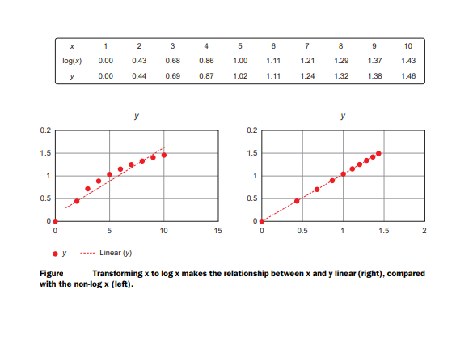
Continue…

Slide 17
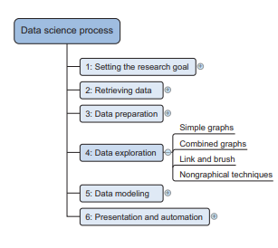
Step 4: Exploratory data analysis
During exploratory data analysis take a deep dive into the data (see figure).
Information becomes much easier to grasp when shown in a picture, therefore mainly use graphical techniques to gain an understanding of data and the interactions between variables.
The visualization techniques use in this phase range from simple line graphs or histograms, as shown in figure , to more complex diagrams such as Sankey and network graphs.
Sometimes it’s useful to compose a composite graph from simple graphs to get even more insight into the data.
Other times the graphs can be animated or made interactive to make it easier and, let’s admit it, way more fun.
An example of an interactive Sankey diagram can be found at http://bost.ocks.org/ mike/sankey/.

Slide 18
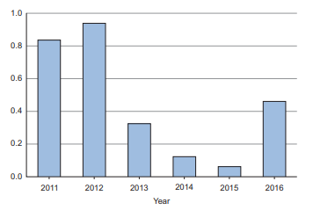
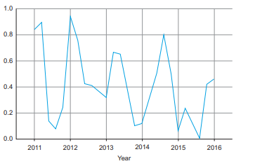
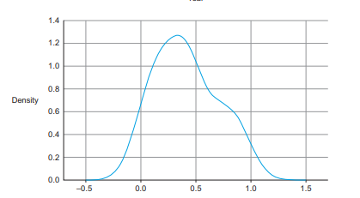
Continue…
From top to bottom, a bar chart, a line piot, and a distribution are some of the graphs used in exploratory analysis.
bar chart line piot
Distribution graphs

Slide 19
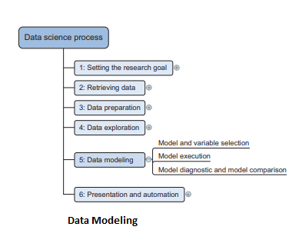
Step 5: Build the models
Build models with the goal of making better predictions, classifying objects, or gaining an understanding of the system modeling.
Building a model is an iterative process.
The way you build model depends on whether to go with classic statistics or the somewhat more recent machine learning school, and the type of technique want to use.
Either way, most models consist of the following main steps:
1 Selection of a modeling technique and variables to enter in the model 2 Execution of the model 3 Diagnosis and model comparison

Slide 20
Model and variable selection
Need to select the variables want to include in model and a modeling technique.
Need to consider model performance and whether project meets all the requirements to use model, as well as other factors:
■ Must the model be moved to a production environment and, if so, would it be easy to implement?
■ How difficult is the maintenance on the model: how long will it remain relevant if left untouched?
■ Does the model need to be easy to explain? When the thinking is done, it’s time for action.

Slide 21
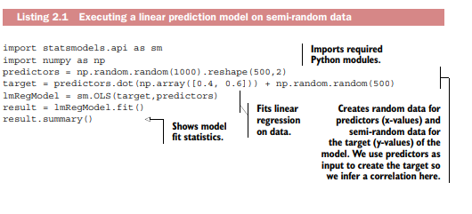
Model execution
Once chosen a model, need to implement it in code. Most programming languages, such as Python, already have libraries such as StatsModels or Scikit-learn.
These packages use several of the most popular techniques.
Coding a model is a nontrivial task in most cases, so having these libraries available can speed up the process.
in the following code, it’s fairly easy to use linear regression (figure) with StatsModels or Scikit-learn.
The following listing shows the execution of a linear prediction model.

Slide 22
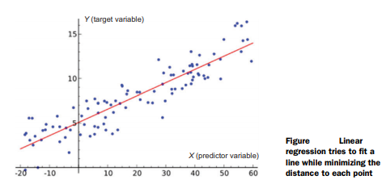
Linear regression
For a linear regression, a “linear relation” between each x (predictor) and the y (target) variable is assumed, as shown in figure .
However, created the target variable, based on the predictor by adding a bit of randomness.
It shouldn’t come as a surprise that this gives us a well-fitting model.

Slide 23
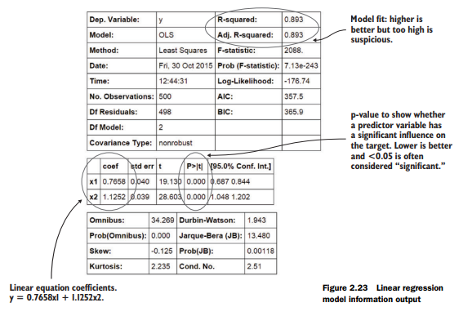
Linear regression model information output
The results.summary() outputs the table in figure.
The exact outcome depends on the random variables.

Slide 24

Model diagnostics and model comparison
Working with a holdout sample helps to pick the best-performing model.
A holdout sample is a part of the data to leave out of the model building so it can be used to evaluate the model afterward.
The principle here is simple: the model should work on unseen data.
use only a fraction of data to estimate the model and the other part, the holdout sample, is kept out of the equation.
The model is then unleashed on the unseen data and error measures are calculated to evaluate it.
Multiple error measures are available in the equation, show the general idea on comparing models.
The error measure used in the example is the mean square error

Slide 25
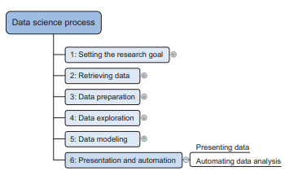
Step 6: Presenting findings and building applications on top of them
After successfully analyzed the data and built a well-performing model,
Need to automate models.
The last stage of the data science process is where soft skills will be most useful, and yes, they’re extremely important.
Presentation and automation
Finally, present the results to business.
These results can take many forms, ranging from presentations to research reports.
Sometimes need to automate the execution of the process because the business will want to use the insights gained in another project or enable an operational process to use the outcome from model.

Slide 26
Data Wrangling
Data wrangling is a generic phrase capturing the range of tasks involved in preparing the data for analysis.
Data wrangling begins with accessing data. Sometimes, access is gated on getting appropriate permission and making the corresponding changes in data infrastructure.
Access also involves manipulating the locations and relationships between datasets.
This kind of data wrangling involves everything from moving datasets around a folder hierarchy, to replicating datasets across warehouses for easier access, to analyzing differences between similar datasets and assessing overlaps and conflicts.
After successfully accessed the data, the bulk of data wrangling work will involve transforming the data itself—manipulating the structure, granularity, accuracy, temporality, and scope of data to better align with analysis goals.

Slide 27
Continue…
All of these transformations are best performed with tools that provide meaningful feedback (so that the manipulator is assured that the manipulations were successful).
Refer to this feedback as profiling.
In many cases, a predefined (and, hence, some‐ what generic) set of profiling feedback is sufficient to determine whether an applied transformation was successful.
In other cases, customized profiling is required to make this determination.
In either event, the bulk of data wrangling involves frequent iterations between transforming and profiling data
A final set of data wrangling tasks can be understood as publishing.
Publishing is best understood from the perspective of what is published.
In some cases, what is published is a transformed version of the input datasets (e.g., in the design and creation of “refined” datasets).
In other cases, the published entity is the transformation logic itself (e.g., as a script that generates the range of statistics and insights in a regular report).
A final kind of publishing involves creating profiling metadata about the dataset.
These profiling reports are critical for managing automated data services and products.

Slide 28
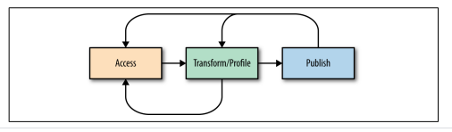
Continue…
A simple diagram illustrating the basic steps of data wrangling
The above diagram illustrates the simple relationship between these data wrangling steps.
Wrangling begins with access. From there, the bulk of time and energy is spent transforming and profiling the results of the transformation.
Finally, the desired output is published for downstream consumption. Realistically, data wrangling is far more iterative.
In addition to iterations between transforming and profiling the data, there are less frequent iterations that return to accessing data.

Slide 29
Continue…
After publishing a result, the output is not exactly correct and need to apply additional transformations or expose some additional profiling results.
These iterations are captured in the diagram.
The work begins by obtaining access to data.
The dataset in a file and need to do little more than double-click to open it.
In other cases, might need to submit a request for access and obtain the necessary credentials.
With the data in hand, the bulk of data wrangling involves iterating between applying transformations and assessing the impact of those transformations through profiling.
After have the modified dataset as desired, or authored a robust data transformation script, or produced the profiling statistics and visualizations that showcase aspects of the dataset, any or all of these outputs must be published.

